Slide 1
Lesson objective
Aims:
Know the meaning of ‘congruent’.
Know the conditions for congruence.
Be able to demonstrate that 2 triangles are congruent.
Plan:
View examples of congruent and non-congruent pairs of triangles.
Complete guided notes.
Complete worksheet.

Slide 2
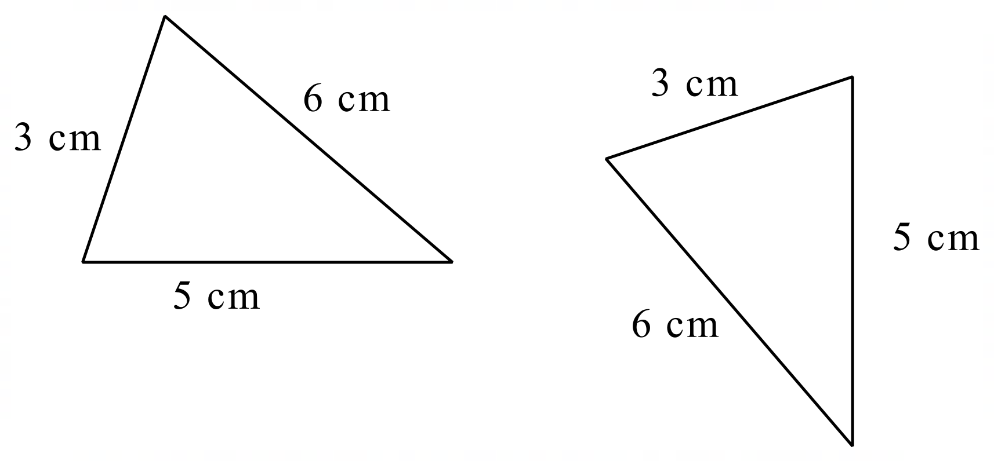
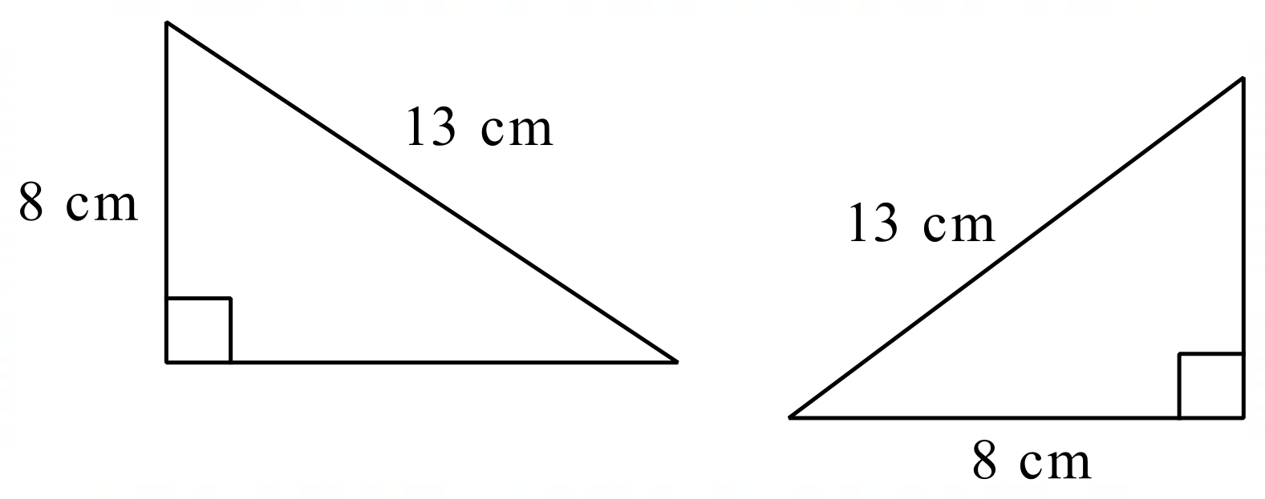
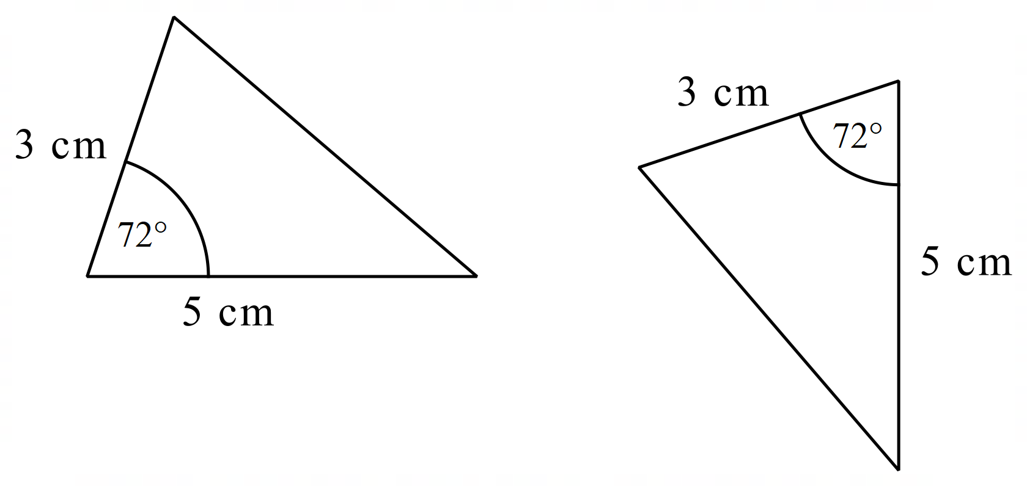
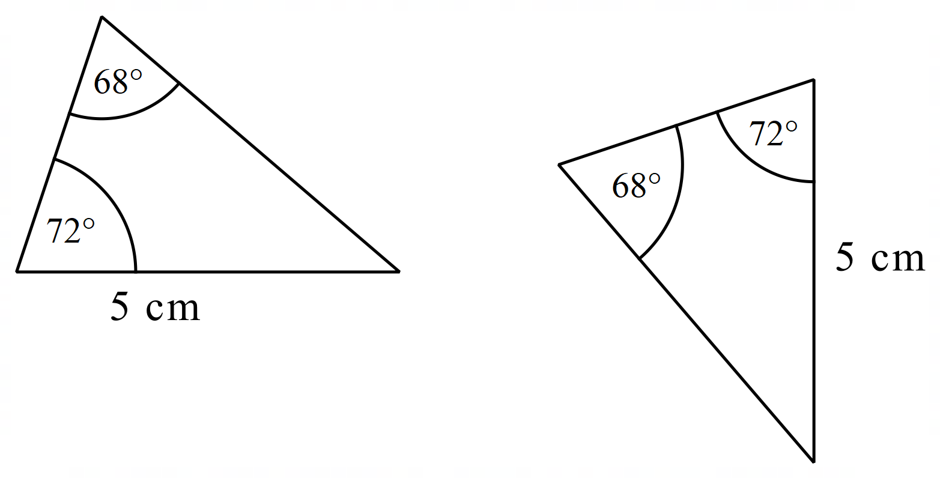
Congruent: same size and shape
Congruent triangles
Notes:
Student notes 1

Slide 3
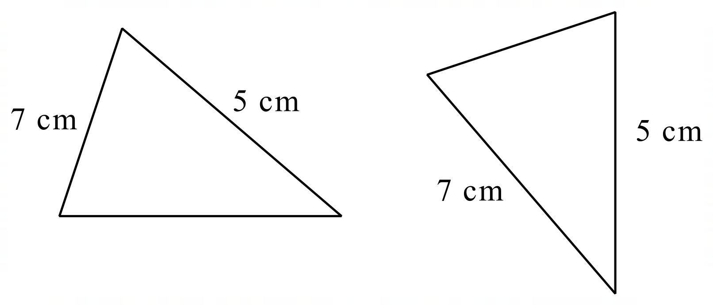
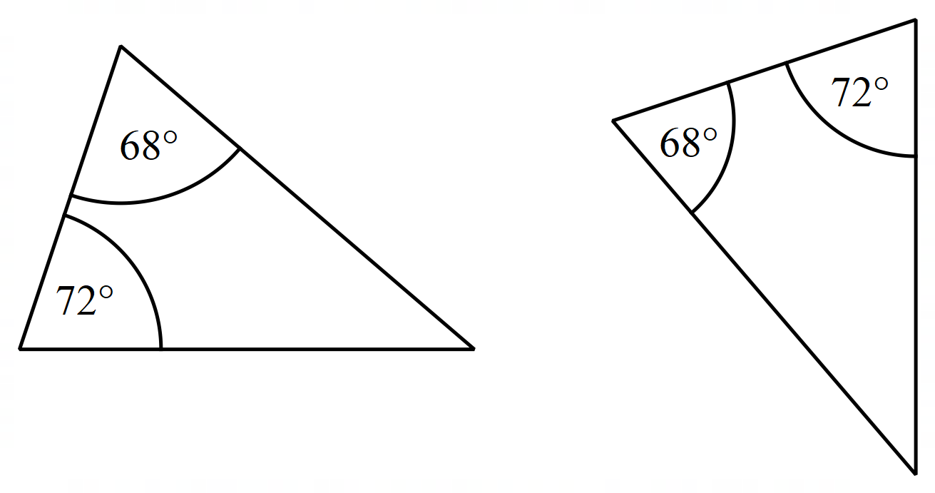
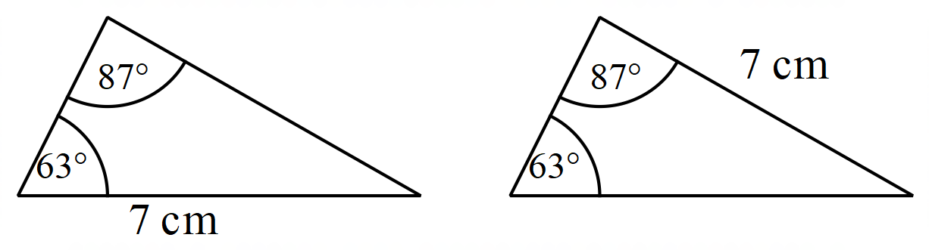
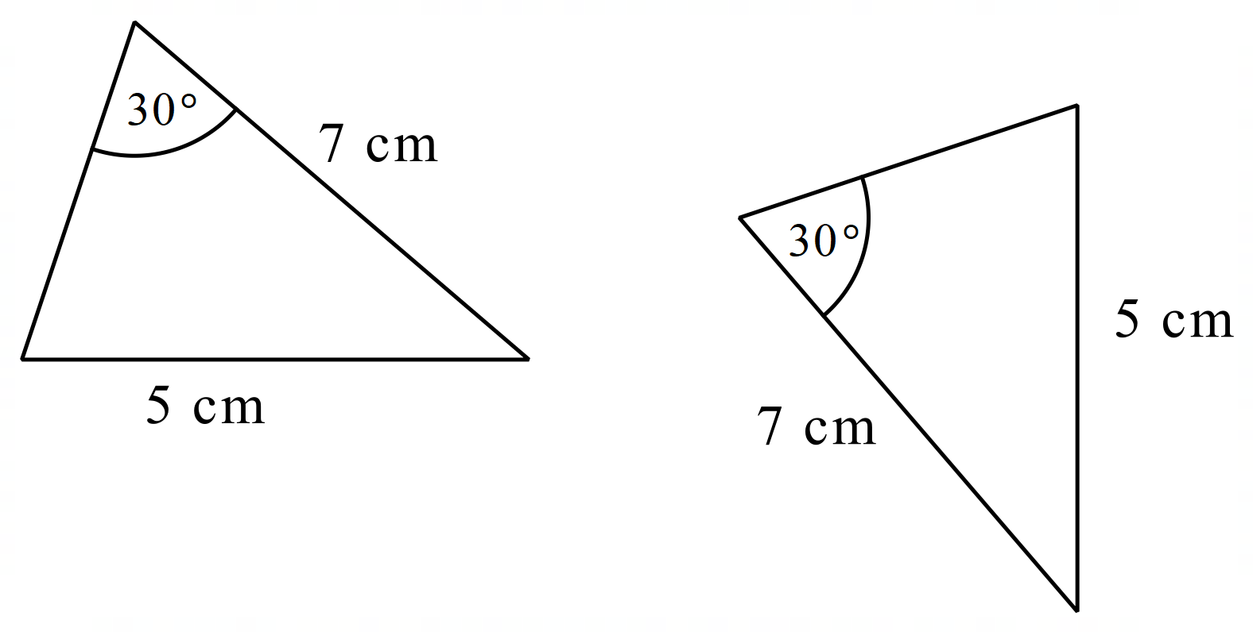
Congruent: same size and shape
Not congruent triangles
Notes:
Student notes 2

Slide 4
Conditions for congruence
SSS If 3 sides of one triangle are congruent to 3 sides of another triangle, then the triangles are congruent.
SAS If 2 sides and the included angle of one triangle are congruent to 2 sides and the included angle of another triangle, then the triangles are congruent.
AAS If 2 angles and a side of one triangle are congruent to 2 angles and the corresponding side of another triangle, then the triangles are congruent.
RHS If the hypotenuse and another side of one right triangle are congruent to the hypotenuse and a side of another triangle, then the triangles are congruent.
Notes:
Student notes 3

Slide 5
Conditions for congruence
SSS If 3 sides of one triangle are congruent to 3 sides of another triangle, then the triangles are congruent.
SAS If 2 sides and the included angle of one triangle are congruent to 2 sides and the included angle of another triangle, then the triangles are congruent.
AAS If 2 angles and a side of one triangle are congruent to 2 angles and the corresponding side of another triangle, then the triangles are congruent.
RHS If the hypotenuse and another side of one right triangle are congruent to the hypotenuse and a side of another triangle, then the triangles are congruent.
Notes:
Student notes 3

Slide 6
Why are these triangles congruent?
They are congruent because all the sides are the same (SSS)
Congruent
SSS If 3 sides of one triangle are congruent to 3 sides of another triangle, then the triangles are congruent.

Slide 7
Why are these triangles congruent?
They are congruent because all angles are the same and one of the corresponding side is the same to (AAS)
Congruent
Congruent
AAS If 2 angles and a side of one triangle are congruent to 2 angles and the corresponding side of another triangle, then the triangles are congruent.

Slide 8
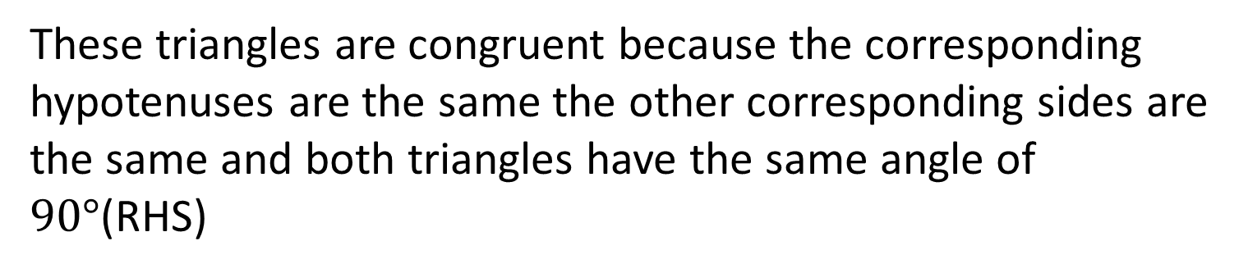
Why are these triangles congruent?
These triangles are congruent because the corresponding hypotenuses are the same the other corresponding sides are the same and both triangles have the same angle of $90°$(RHS)
Congruent
Congruent
Congruent
RHS If the hypotenuse and another side of one right triangle are congruent to the hypotenuse and a side of another triangle, then the triangles are congruent.

Slide 9
Why are these triangles congruent?
They are congruent because all angles are the same and one of the corresponding side is the same to (AAS)
Congruent
Congruent
AAS If 2 angles and a side of one triangle are congruent to 2 angles and the corresponding side of another triangle, then the triangles are congruent.

Slide 10
Why are these triangles congruent?
They are congruent because 2 corresponding sides on each triangle are the same and the angle they make is the same (AAS)
Congruent
Congruent
SAS If 2 sides and the included angle of one triangle are congruent to 2 sides and the included angle of another triangle, then the triangles are congruent.

